Slide 1
Object Detection
By : Ahmed Haytham
Data science head at GDSC Damnhour

Slide 2
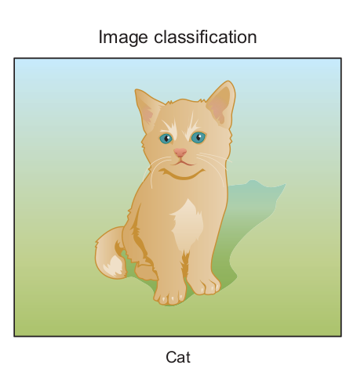
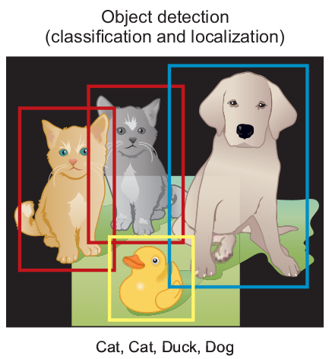
Object detection
Object detection is a CV task that involves both main tasks: localizing one or more objects within an image and classifying each object in the image

Slide 3
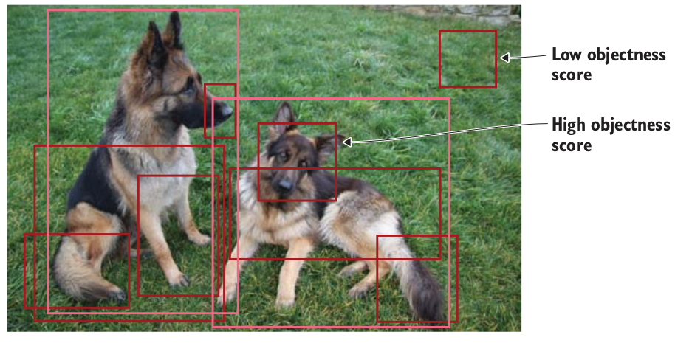
Object detection framework
an object detection framework has four components:
1_Region proposal
In this step, the system looks at the image and proposes RoIs for further analysis
1
the selective
search algorithm was used to generate object proposals
2
the network analyzes these regions in the image and classifies each region as fore-
ground (object) or background (no object)

Slide 4
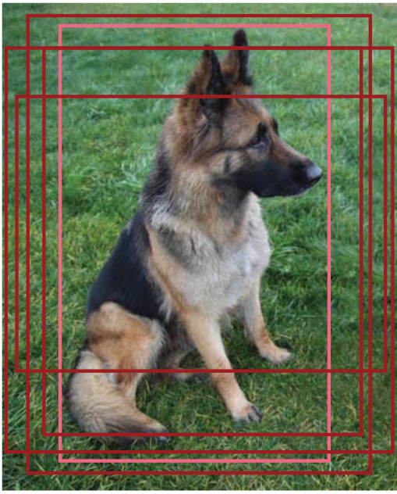
Object detection framework
an object detection framework has four components:
2_ Network predictions
This component includes the pretrained CNN network that is used for feature extraction to extract features from the input image
Bounding-box prediction—The coordinates that locate the box surrounding the
object. The bounding box coordinates are represented as the tuple (x, y, w, h),
the dog was present in the five RoIs
Class prediction: The classic softmax function that predicts the class probability for each object.

Slide 5
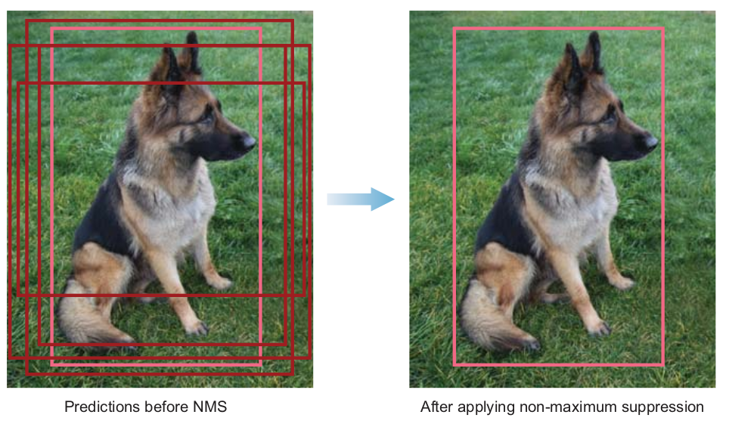
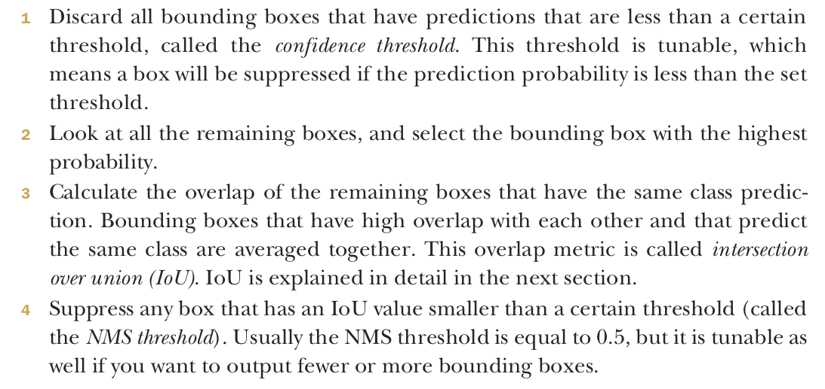
Object detection framework
an object detection framework has four components:
3_ Non-maximum suppression (NMS)
one of the problems of an object detection algorithm is that it may find multiple detections of the same object. So, instead of creating only one bounding box around the object, it draws multiple boxes

Slide 6
Object detection framework
an object detection framework has four components:
4_ Object-detector evaluation metrics
When evaluating the performance of an object detector, we use two main evaluation metrics: frames per second and mean average precision.
FRAMES PER SECOND (FPS) TO MEASURE DETECTION SPEED
Network X achieves mAP of Y% at Z FPS,” where X is the network name, Y is the mAP percentage, and Z is the FPS
MEAN AVERAGE PRECISION (MAP) TO MEASURE NETWORK PRECISION
The most common evaluation metric used in object recognition tasks is mean average
precision (mAP). It is a percentage from 0 to 100, and higher values are typically better,
but its value is different from the accuracy metric used in classification.
IOU
PR curve

Slide 7
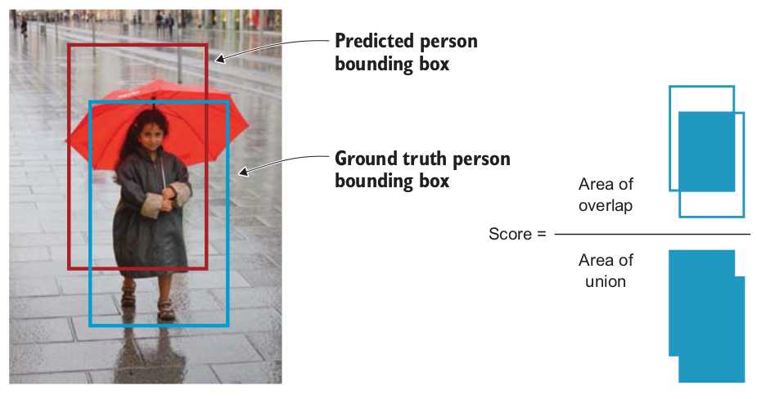
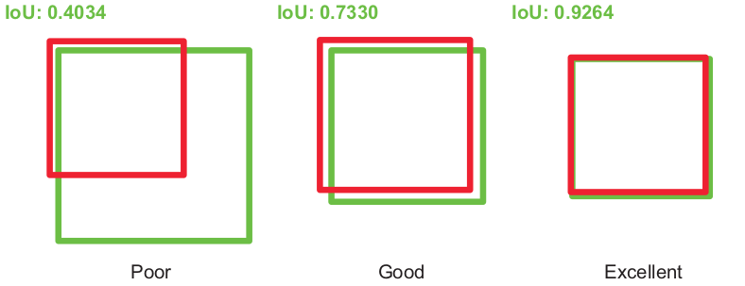
Object detection framework
INTERSECTION OVER UNION (IOU)

Slide 8
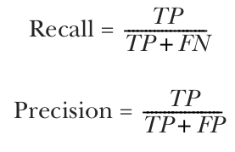
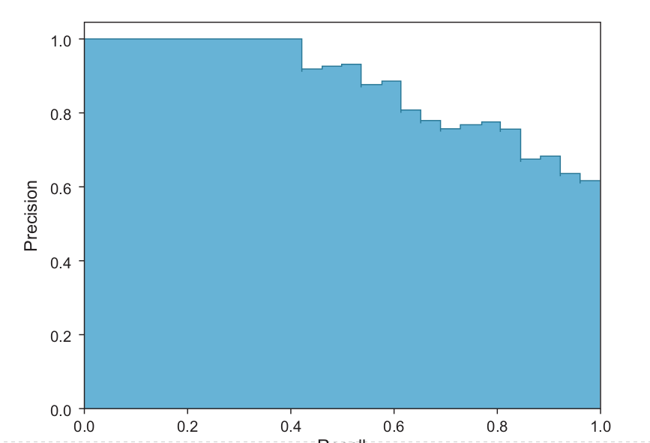
Object detection framework
Now that we have the PR curve, we can calculate the average precision (AP) by calculating the area under the curve (AUC). Finally, the mAP for object detection is the average of the AP calculated for all the classes

Slide 9
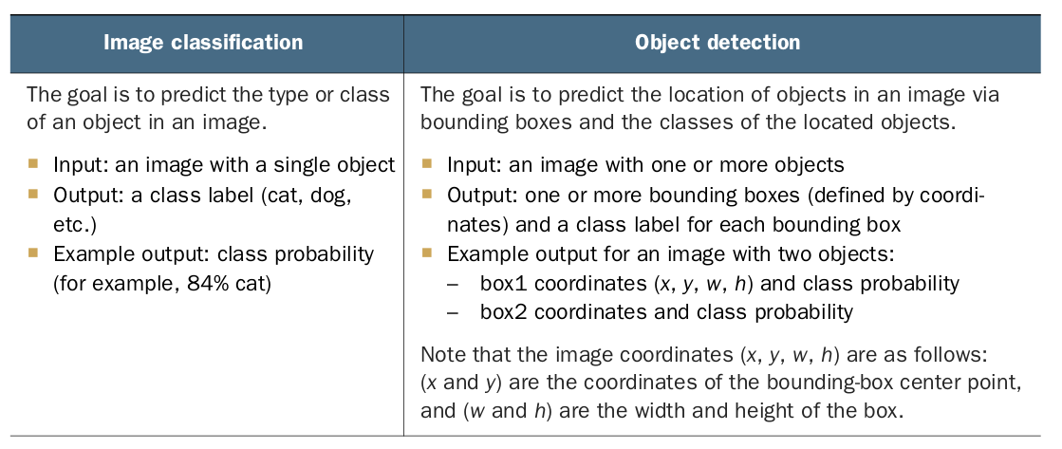

Slide 10
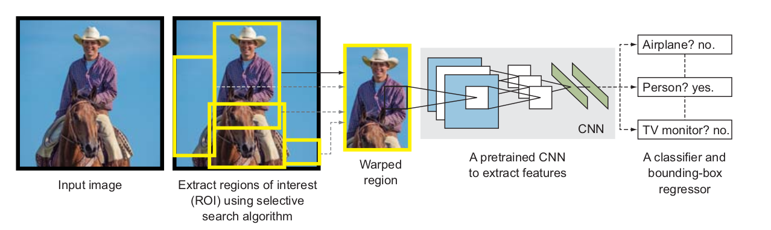
R_CNN ⇒ Region-based

Slide 11
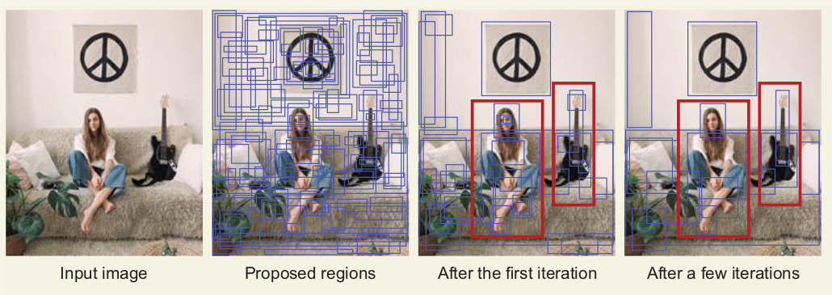
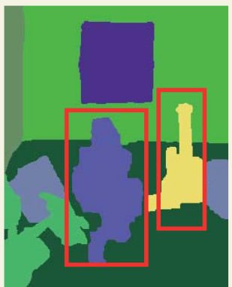
Selective search
Selective search is a greedy search algorithm that is used to provide region proposals that potentially contain objects.
The similarities between all neighboring regions are calculated.
The two most similar regions are grouped together, and new similarities are calculated between the resulting region and its neighbors.
This process is repeated until the entire object is covered in a single region.

Slide 12
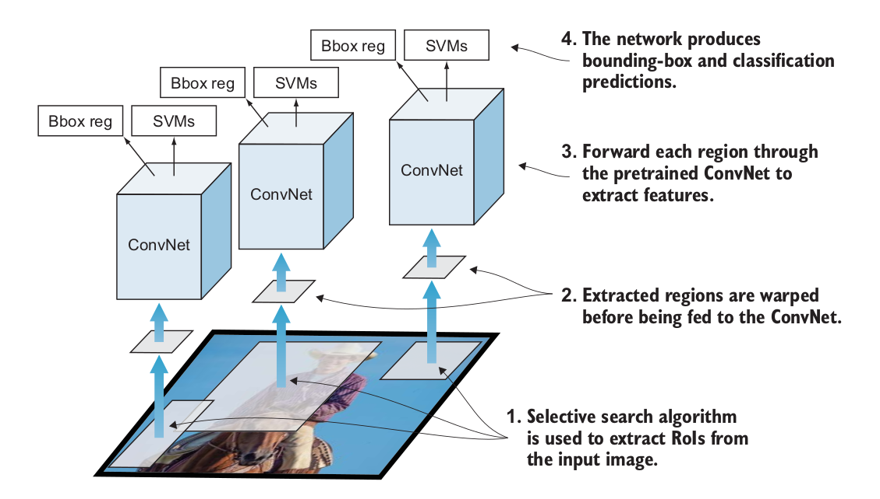
R_CNN ⇒ Region-based
DISADVANTAGES OF R-CNN
1_ Object detection is very slow
search algorithm pro-
poses about 2,000 RoIs
2_ Training is a multi-stage pipeline
3_ Training is expensive in terms of space and time

Slide 13
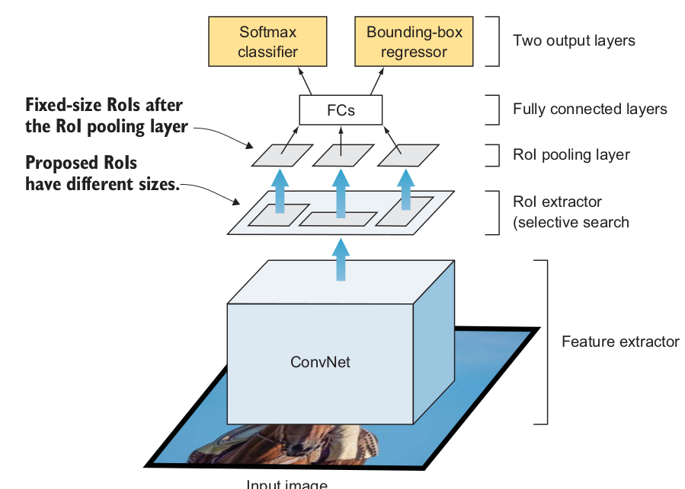
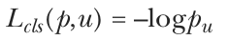
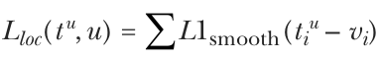
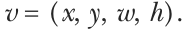
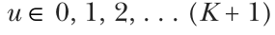
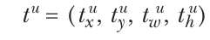
Fast R_CNN ⇒ Region-based
Feature extractor module —The network starts with a ConvNet to extract features from the full image.
RoI extractor — The selective search algorithm proposes about 2,000 region candidates per image.
RoI pooling layer — This is a new component that was introduced to extract a fixed-size window from the feature map before feeding the RoIs to the fully connected layers
Two-head output layer — The model branches into two heads:
– A softmax classifier layer that outputs a discrete probability distribution per RoI
– A bounding-box regressor layer to predict offsets relative to the original RoI
Loss function for classification | Loss function for Regression

Slide 14
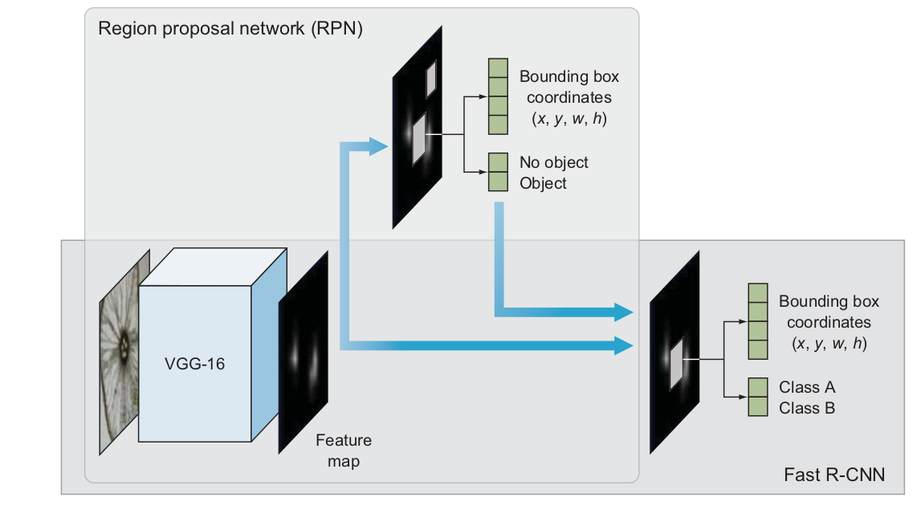
Faster R_CNN ⇒ Region-based
Region proposal network (RPN) — Selective search is replaced by a ConvNet that proposes RoIs from the last feature maps of the feature extractor to be considered for investigation. The RPN has two outputs: the objectness score (object or no object) and the box location.
Fast R-CNN — It consists of the typical components of Fast R-CNN:

Slide 15
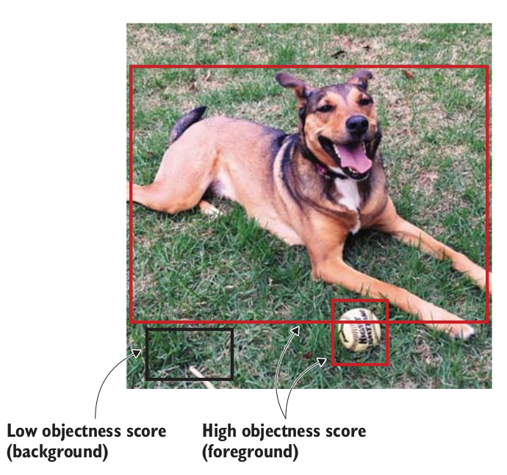
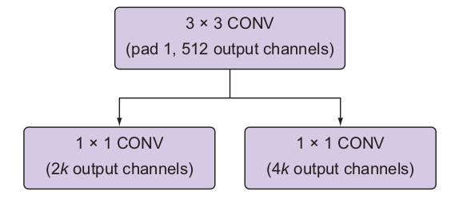
REGION PROPOSAL NETWORK (RPN)
A 3 × 3 fully convolutional layer with 512 channels
Two parallel 1 × 1 convolutional layers: a classification layer that is used to predict whether the region contains an object (the score of it being background or foreground), and a layer for regression or bounding box prediction.
(the score of it being background or foreground), and a layer for regression or bounding box prediction.

Slide 16
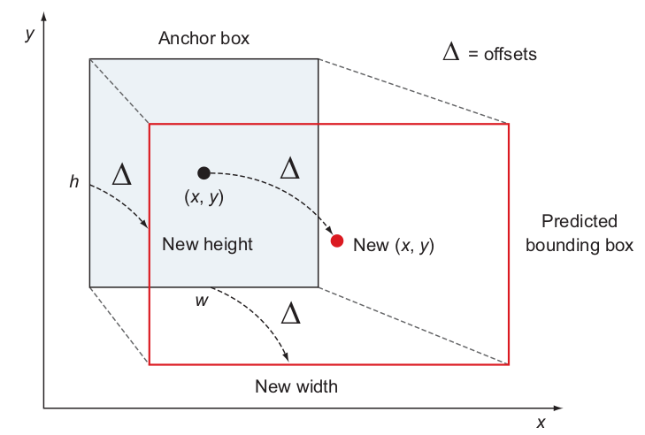
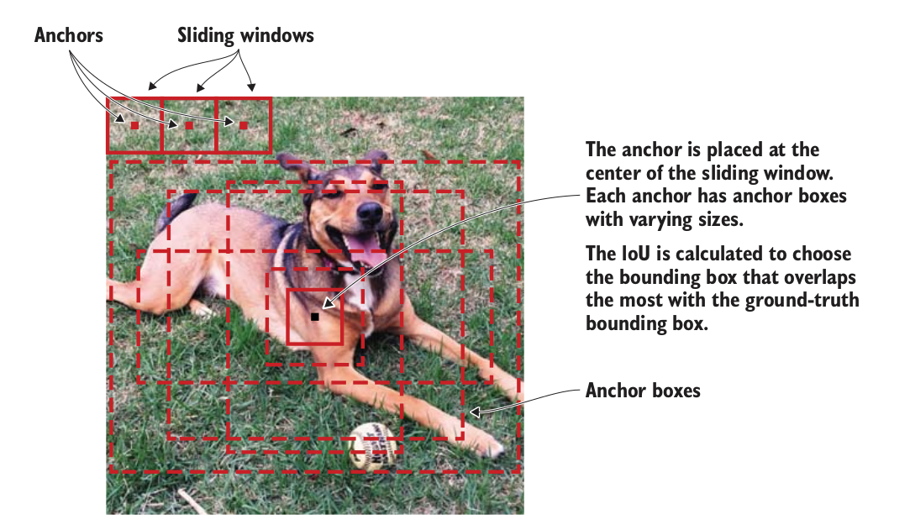
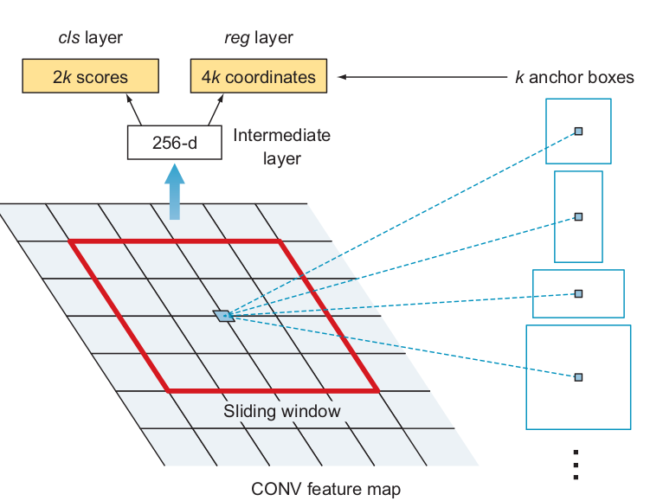
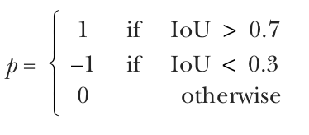
REGION PROPOSAL NETWORK (RPN)
deltas (Δx, Δy, Δw, Δh) to adjust the anchor boxes to better fit the object to get final
proposals (figure 7.14)

Slide 17
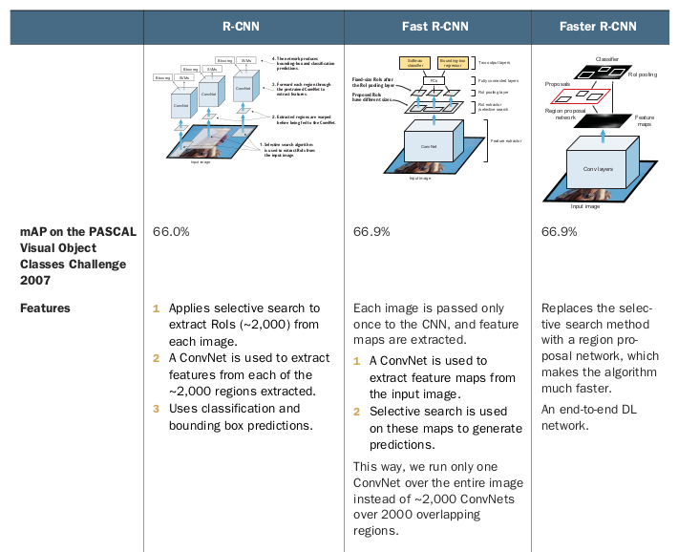

Slide 18
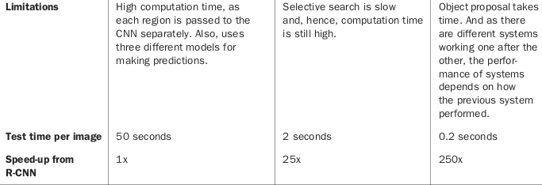

Slide 19
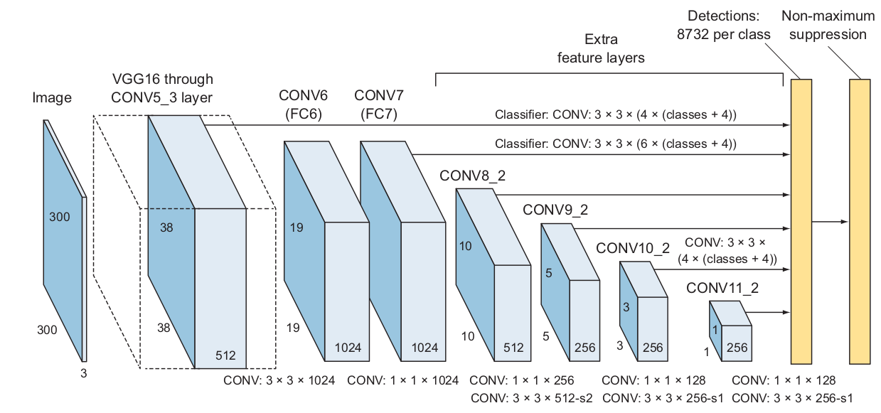
High-level SSD architecture
Base network to extract feature maps — A standard pretrained network used for high-quality image classification, which is truncated before any classification layers. In their paper, Liu et al. used a VGG16 network. Other netw
Multi-scale feature layers — A series of convolution filters are added after the base network. These layers decrease in size progressively to allow predictions of detections at multiple scales.
Non-maximum suppression — NMS is used to eliminate overlapping boxes and keep only one box for each object detected.

Slide 20
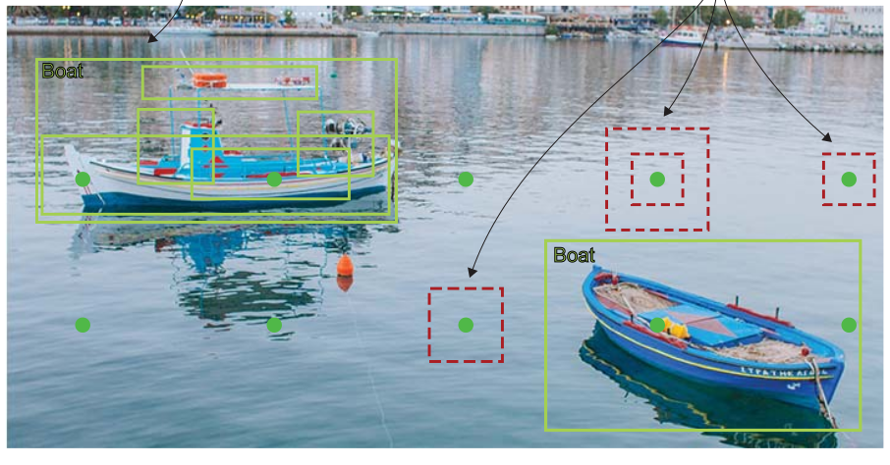
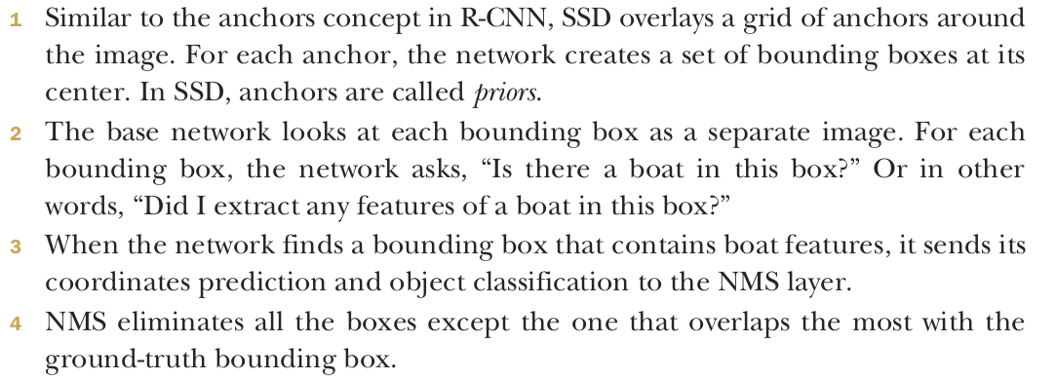
Base network

Slide 21
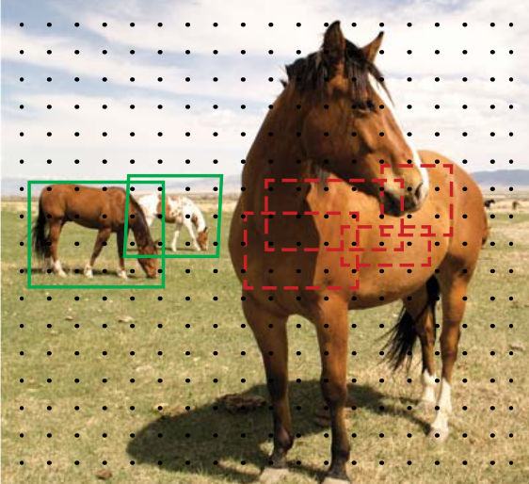
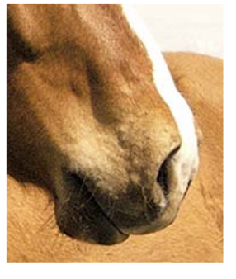
Multi-scale feature layers
These are convolutional feature layers that are added to the end of the truncated base network. These layers decrease in size progressively to allow predictions of detections at multiple scales.

Slide 22
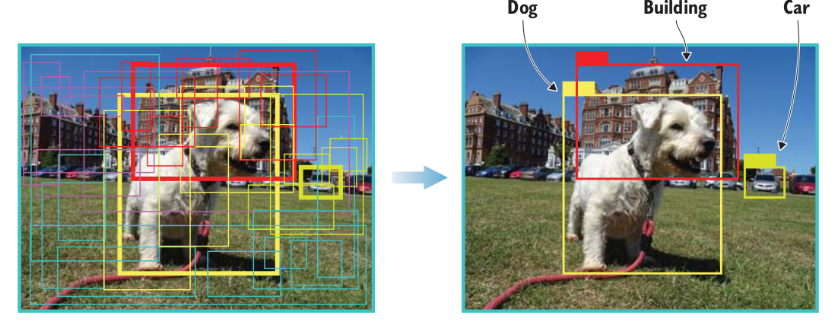
Non-maximum suppression
Given the large number of boxes generated by the detection layer per class during a forward pass of SSD at inference time, it is essential to prune most of the bounding box by applying the NMS technique

Slide 23
You only look once (YOLO)
YOLOv1, published in 2016—Called “unified, real-time object detection” because it is a single-detection network that unifies the two components of a detector: object detector and class predictor.
YOLOv2 (also known as YOLO9000), published later in 201610—Capable of detecting over 9,000 objects; hence the name. It has been trained on ImageNet and COCO datasets and has achieved 16% mAP, which is not good; but it was very fast during test time.
YOLOv3, published in 201811—Significantly larger than previous models and has achieved a mAP of 57.9%, which is the best result yet out of the YOLO family of object detectors.
The YOLO family is a series of end-to-end DL models designed for fast object detection

Slide 24
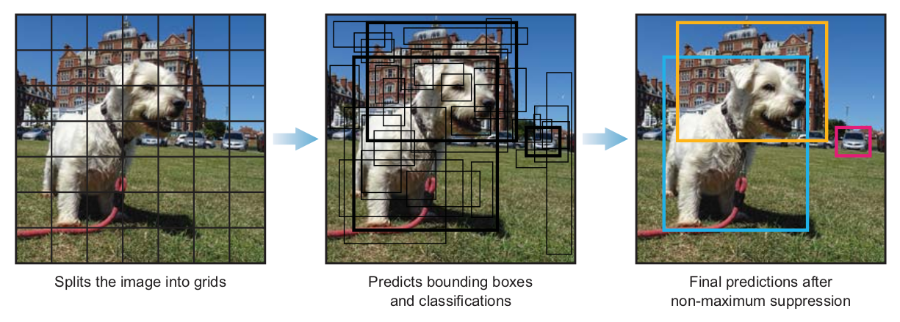
You only look once (YOLO)
YOLO splits the image into grids, predicts objects for each grid, and then uses NMS to finalize predictions.
The YOLO family is a series of end-to-end DL models designed for fast object detection

Slide 25
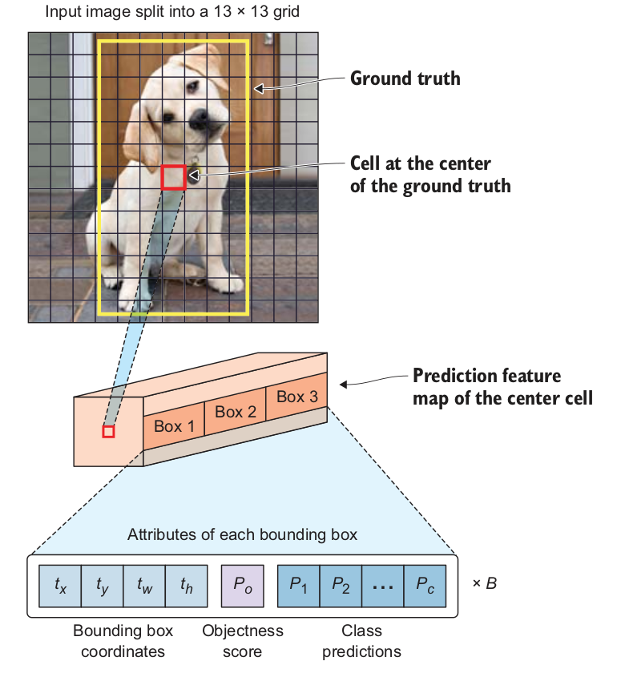
How YOLOv3 works
The YOLO network splits the input image into a grid of S × S cells.
If the center of the
ground-truth box falls into a cell, that cell is responsible for detecting the existence of that object
If the center of the ground-truth box falls into a cell, that cell is responsible for detecting the existence of that object
Objectness score (P 0)—indicates the probability that the cell contains an object. The objectness score is passed through a sigmoid function to be treated as a probability with a value range between 0 and 1. The objectness score is calculated as follows:
P 0 = Pr (containing an object) × IoU (pred, truth)
Class prediction—If the bounding box contains an object, the network predicts the probability of K number of classes, where K is the total number of classes in your problem

Slide 26
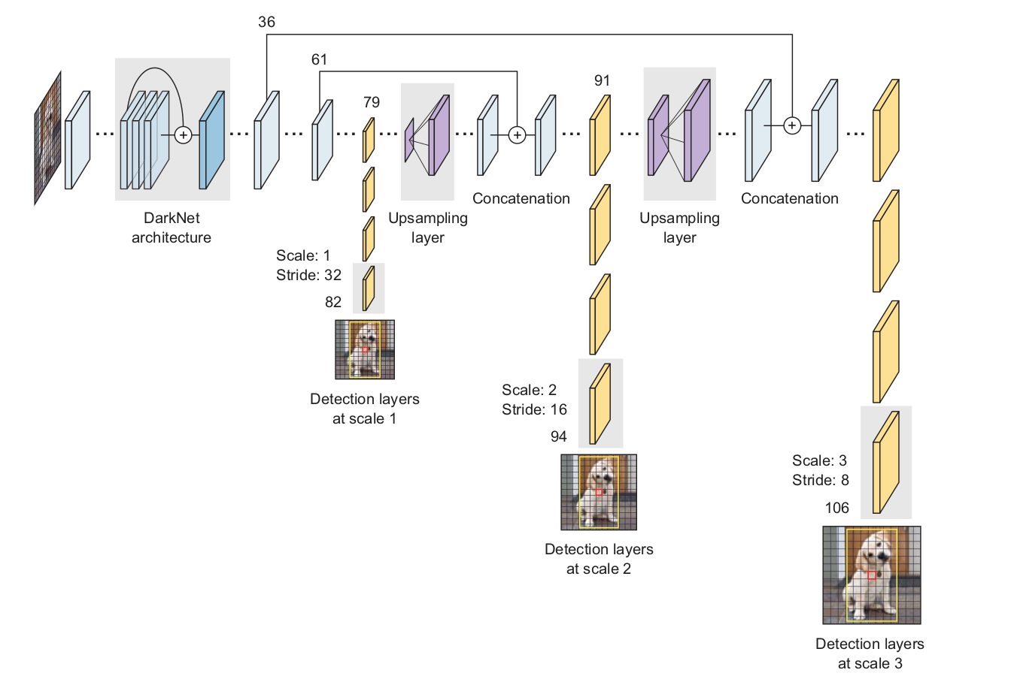
YOLO v3 architecture

Slide 27
Thank
You

